Slide 1



Class 4: Introduction to Machine Learning
Unit II: Data Preparation and Predictive Models
Sebastián Muñoz-Herrera, PhD.
Héctor Hormazábal

Slide 2
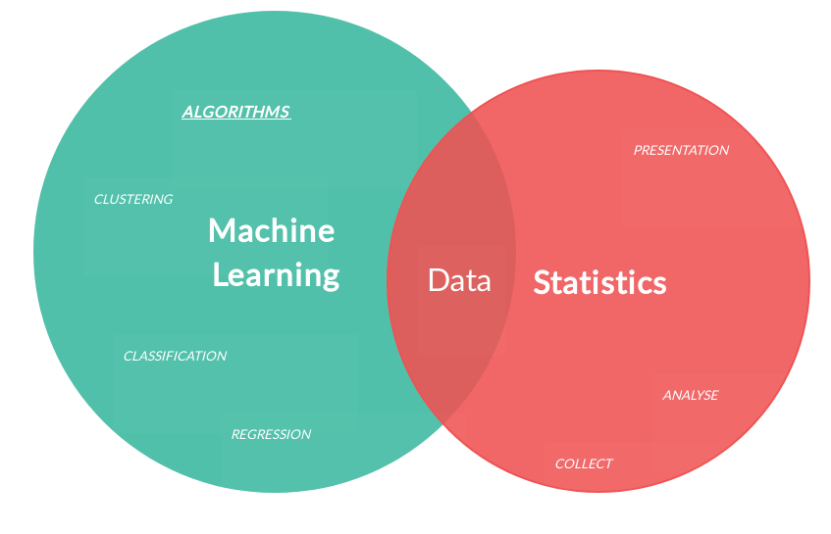
Shifting the Analytics Paradigm: Descriptive - Predictive BI
The business goal
Transitioning from Insight to Action: Moving beyond traditional reporting by treating historical data as the raw material for predictive models.
Quantifying Uncertainty: Shifting the decision-making process from intuition toward statistically validated frameworks that measure risk and expected outcomes.
Operational Integration: Embedding predictive capabilities into core business processes to optimize resource allocation and cost efficiency.
Driving Strategic Value: Creating a competitive advantage by anticipating market shifts and customer behavior before they impact the bottom line.
Muñoz-Herrera and Hormazábal Class 4: Data Preparation and Predictive Models Unit II: Introduction to Machine Learning
Notes:
Let me walk you through the four units of the course so you know exactly where we're headed.
Unit I, which starts today, covers the Fundamentals of Business Intelligence — what it is, how it works, where data comes from.
Unit II moves into Data Preparation and Predictive Models — this is where you'll get your hands dirty cleaning and modeling data.
Unit III is the exciting one: Advanced Analytics and Machine Learning.
And Unit IV brings it all together with a focus on communicating insights ethically to support decision-making.
Notice how the course is structured like a pipeline: first you understand BI, then you prepare data, then you build models, and finally you communicate results. Each unit builds on the previous one — so keeping up with the pace really matters.
If at any point you feel lost, reach out early. We'd rather help you now than rescue you at the final exam.

Slide 3
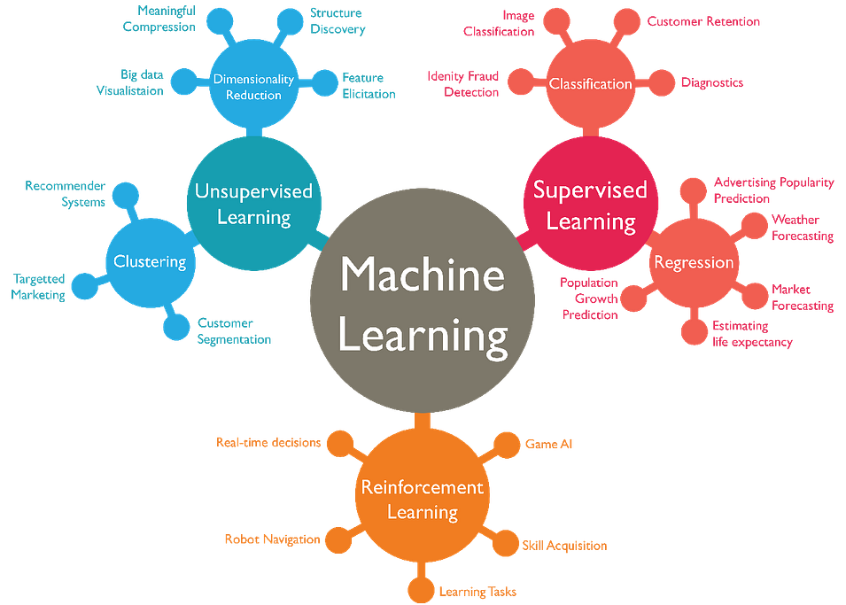
Machine Learning Taxonomy
Architectural Selection Based on Data Structures
Muñoz-Herrera and Hormazábal Class 4: Data Preparation and Predictive Models Unit II: Introduction to Machine Learning
Notes:
Let me walk you through the four units of the course so you know exactly where we're headed.
Unit I, which starts today, covers the Fundamentals of Business Intelligence — what it is, how it works, where data comes from.
Unit II moves into Data Preparation and Predictive Models — this is where you'll get your hands dirty cleaning and modeling data.
Unit III is the exciting one: Advanced Analytics and Machine Learning.
And Unit IV brings it all together with a focus on communicating insights ethically to support decision-making.
Notice how the course is structured like a pipeline: first you understand BI, then you prepare data, then you build models, and finally you communicate results. Each unit builds on the previous one — so keeping up with the pace really matters.
If at any point you feel lost, reach out early. We'd rather help you now than rescue you at the final exam.

Slide 4
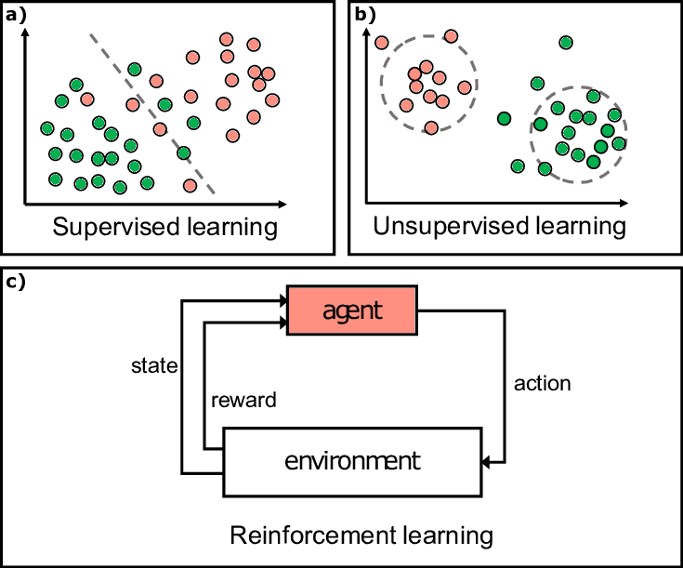
Machine Learning Taxonomy
Architectural Selection Based on Data Structures
Signal-Based Classification: Categorizing models by the type of feedback available—shifting from predictive mapping to structural discovery.
Supervised Learning Architectures: Establishing functional relationships between input features and target variables for regression or classification.
Unsupervised Pattern Extraction: Identifying latent structures and natural clusters in high-dimensional data without predefined output labels.
Reinforcement Learning & Dynamic Control: Optimizing sequential decision-making through agent-environment interaction to maximize long-term performance (rewarding)
Muñoz-Herrera and Hormazábal Class 4: Data Preparation and Predictive Models Unit II: Introduction to Machine Learning
Notes:
Let me walk you through the four units of the course so you know exactly where we're headed.
Unit I, which starts today, covers the Fundamentals of Business Intelligence — what it is, how it works, where data comes from.
Unit II moves into Data Preparation and Predictive Models — this is where you'll get your hands dirty cleaning and modeling data.
Unit III is the exciting one: Advanced Analytics and Machine Learning.
And Unit IV brings it all together with a focus on communicating insights ethically to support decision-making.
Notice how the course is structured like a pipeline: first you understand BI, then you prepare data, then you build models, and finally you communicate results. Each unit builds on the previous one — so keeping up with the pace really matters.
If at any point you feel lost, reach out early. We'd rather help you now than rescue you at the final exam.

Slide 5
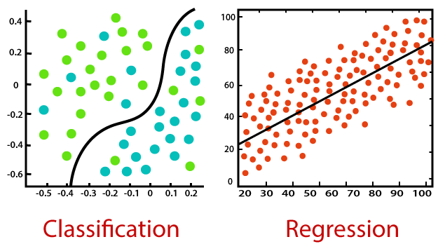
Supervised Learning - Regression vs Classification
Categorizing Supervised Learning Objectives
Output Dimensionality: Distinguishing between continuous numeric variables and discrete categorical boundaries to define the model architecture.
Regression Frameworks: Modeling the conditional expectation of a quantitative target, such as estimating asset valuation or demand volume.
Classification Logic: Partitioning the feature space into mutually exclusive classes to predict event probability or system states.
Impact on Decision Metrics: Aligning the output nature with specific KPIs—shifting from error variance in regression to accuracy and precision in classification.
Muñoz-Herrera and Hormazábal Class 4: Data Preparation and Predictive Models Unit II: Introduction to Machine Learning
Notes:
Let me walk you through the four units of the course so you know exactly where we're headed.
Unit I, which starts today, covers the Fundamentals of Business Intelligence — what it is, how it works, where data comes from.
Unit II moves into Data Preparation and Predictive Models — this is where you'll get your hands dirty cleaning and modeling data.
Unit III is the exciting one: Advanced Analytics and Machine Learning.
And Unit IV brings it all together with a focus on communicating insights ethically to support decision-making.
Notice how the course is structured like a pipeline: first you understand BI, then you prepare data, then you build models, and finally you communicate results. Each unit builds on the previous one — so keeping up with the pace really matters.
If at any point you feel lost, reach out early. We'd rather help you now than rescue you at the final exam.

Slide 6
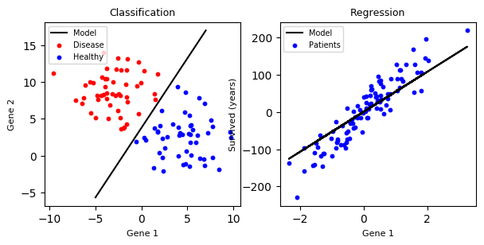
Supervised Learning - Regression vs Classification
Categorizing Supervised Learning Objectives
Muñoz-Herrera and Hormazábal Class 4: Data Preparation and Predictive Models Unit II: Introduction to Machine Learning
Notes:
Let me walk you through the four units of the course so you know exactly where we're headed.
Unit I, which starts today, covers the Fundamentals of Business Intelligence — what it is, how it works, where data comes from.
Unit II moves into Data Preparation and Predictive Models — this is where you'll get your hands dirty cleaning and modeling data.
Unit III is the exciting one: Advanced Analytics and Machine Learning.
And Unit IV brings it all together with a focus on communicating insights ethically to support decision-making.
Notice how the course is structured like a pipeline: first you understand BI, then you prepare data, then you build models, and finally you communicate results. Each unit builds on the previous one — so keeping up with the pace really matters.
If at any point you feel lost, reach out early. We'd rather help you now than rescue you at the final exam.

Slide 7
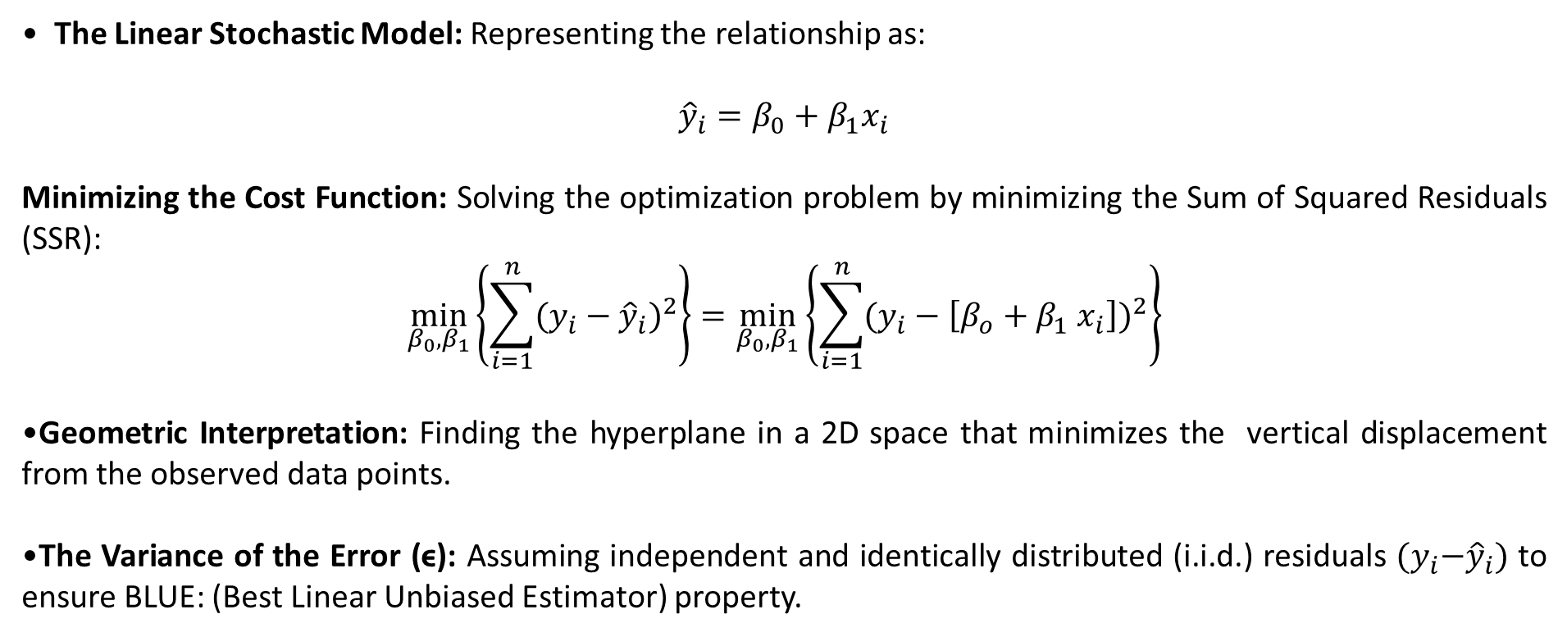
Simple Linear Regression & OLS
Foundations of Ordinary Least Squares (OLS) Optimization
The Linear Stochastic Model: Representing the relationship as:
$${\hat{y}}_{i}=β_{0}+β_{1}x_{i}$$
Minimizing the Cost Function: Solving the optimization problem by minimizing the Sum of Squared Residuals (SSR):
$$\min_{β_{0},β_{1}}\left\{\sum_{i=1}^{n}{{(y_{i}−{\hat{y}}_{i})}^{2}}\right\}=\min_{β_{0},β_{1}}\left\{\sum_{i=1}^{n}{{(y_{i}−\left[β_{o}+β_{1} x_{i}\right])}^{2}}\right\}$$
Geometric Interpretation: Finding the hyperplane in a 2D space that minimizes the vertical displacement from the observed data points.
The Variance of the Error (ϵ): Assuming independent and identically distributed (i.i.d.) residuals ${(y}_{i}−{\hat{y}}_{i})$ to ensure BLUE: (Best Linear Unbiased Estimator) property.
Muñoz-Herrera and Hormazábal Class 4: Data Preparation and Predictive Models Unit II: Introduction to Machine Learning
Notes:
Let me walk you through the four units of the course so you know exactly where we're headed.
Unit I, which starts today, covers the Fundamentals of Business Intelligence — what it is, how it works, where data comes from.
Unit II moves into Data Preparation and Predictive Models — this is where you'll get your hands dirty cleaning and modeling data.
Unit III is the exciting one: Advanced Analytics and Machine Learning.
And Unit IV brings it all together with a focus on communicating insights ethically to support decision-making.
Notice how the course is structured like a pipeline: first you understand BI, then you prepare data, then you build models, and finally you communicate results. Each unit builds on the previous one — so keeping up with the pace really matters.
If at any point you feel lost, reach out early. We'd rather help you now than rescue you at the final exam.

Slide 8
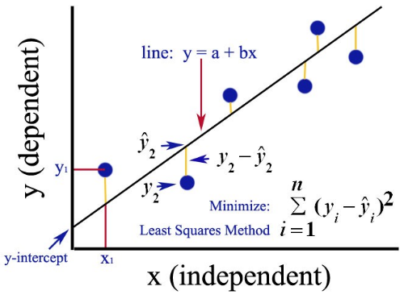
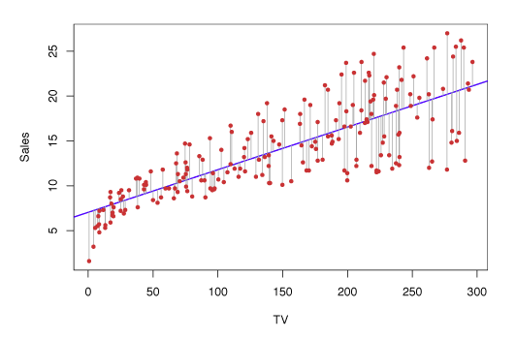
Simple Linear Regression & OLS
Foundations of Ordinary Least Squares (OLS) Optimization
Muñoz-Herrera and Hormazábal Class 4: Data Preparation and Predictive Models Unit II: Introduction to Machine Learning
Notes:
Let me walk you through the four units of the course so you know exactly where we're headed.
Unit I, which starts today, covers the Fundamentals of Business Intelligence — what it is, how it works, where data comes from.
Unit II moves into Data Preparation and Predictive Models — this is where you'll get your hands dirty cleaning and modeling data.
Unit III is the exciting one: Advanced Analytics and Machine Learning.
And Unit IV brings it all together with a focus on communicating insights ethically to support decision-making.
Notice how the course is structured like a pipeline: first you understand BI, then you prepare data, then you build models, and finally you communicate results. Each unit builds on the previous one — so keeping up with the pace really matters.
If at any point you feel lost, reach out early. We'd rather help you now than rescue you at the final exam.

Slide 9
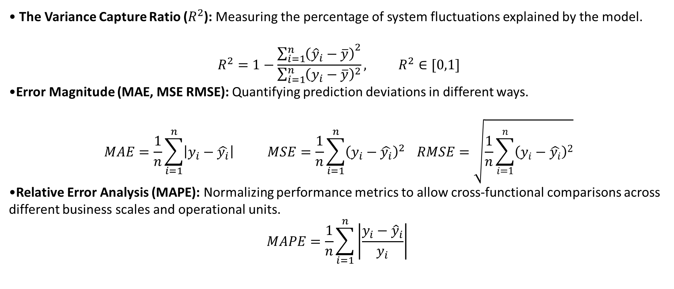
Model Performance & Error Metrics
Quantifying Precision in Operational Forecasting
The Variance Capture Ratio ($R^{2}$): Measuring the percentage of system fluctuations explained by the model.
$$R^{2}=1−\frac{{\sum_{i=1}^{n}{\left({\hat{y}}_{i}−\overline{y}\right)}}^{2}}{\sum_{i=1}^{n}{{\left(y_{i}−\overline{y}\right)}^{2}}}, R^{2}∈[0,1]$$
Error Magnitude (MAE, MSE RMSE): Quantifying prediction deviations in different ways.
$$MAE=\frac{1}{n}\sum_{i=1}^{n}{\left|y_{i}−\hat{y_{i}}\right|} MSE=\frac{1}{n}\sum_{i=1}^{n}{{\left(y_{i}−\hat{y_{i}}\right)}^{2}} RMSE=\sqrt{\frac{1}{n}\sum_{i=1}^{n}{{\left(y_{i}−\hat{y_{i}}\right)}^{2}}}$$
Relative Error Analysis (MAPE): Normalizing performance metrics to allow cross-functional comparisons across different business scales and operational units.
$$MAPE=\frac{1}{n}\sum_{i=1}^{n}{\left|\frac{y_{i}−{\hat{y}}_{i}}{y_{i}}\right|}$$
Muñoz-Herrera and Hormazábal Class 4: Data Preparation and Predictive Models Unit II: Introduction to Machine Learning
Notes:
Let me walk you through the four units of the course so you know exactly where we're headed.
Unit I, which starts today, covers the Fundamentals of Business Intelligence — what it is, how it works, where data comes from.
Unit II moves into Data Preparation and Predictive Models — this is where you'll get your hands dirty cleaning and modeling data.
Unit III is the exciting one: Advanced Analytics and Machine Learning.
And Unit IV brings it all together with a focus on communicating insights ethically to support decision-making.
Notice how the course is structured like a pipeline: first you understand BI, then you prepare data, then you build models, and finally you communicate results. Each unit builds on the previous one — so keeping up with the pace really matters.
If at any point you feel lost, reach out early. We'd rather help you now than rescue you at the final exam.

Slide 10
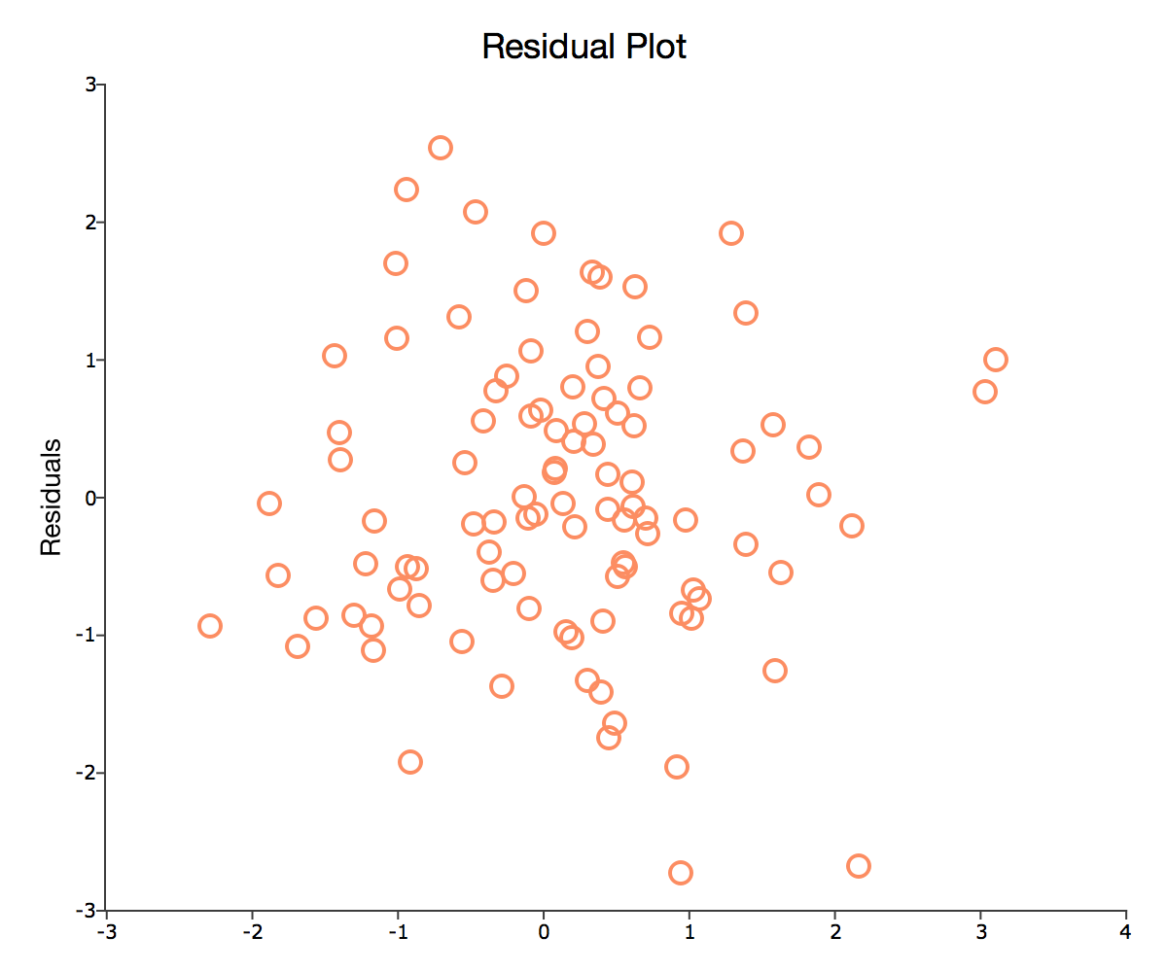
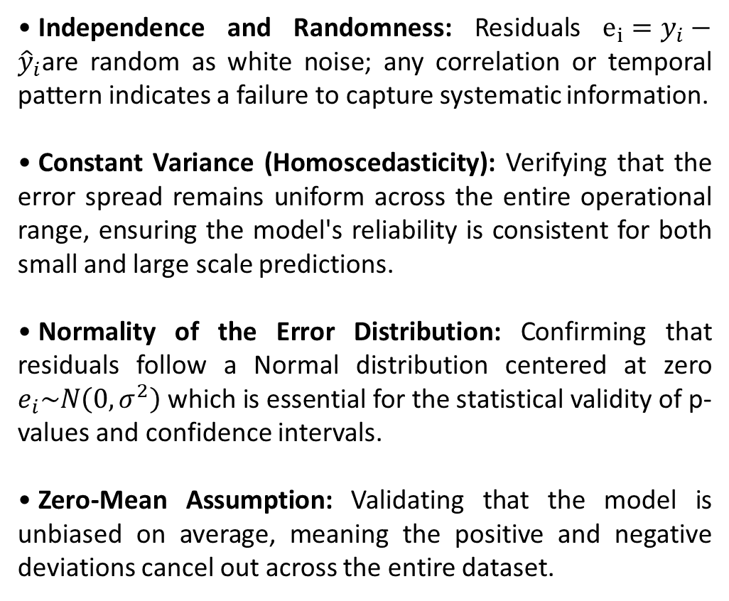
Residual Diagnostics
Validating Model Assumptions and Information Capture
Independence and Randomness: Residuals $e_{i}=y_{i}−{\hat{y}}_{i}$are random as white noise; any correlation or temporal pattern indicates a failure to capture systematic information.
Constant Variance (Homoscedasticity): Verifying that the error spread remains uniform across the entire operational range, ensuring the model's reliability is consistent for both small and large scale predictions.
Normality of the Error Distribution: Confirming that residuals follow a Normal distribution centered at zero $e_{i}\sim N\left(0,σ^{2}\right)$which is essential for the statistical validity of p-values and confidence intervals.
Zero-Mean Assumption: Validating that the model is unbiased on average, meaning the positive and negative deviations cancel out across the entire dataset.
Muñoz-Herrera and Hormazábal Class 4: Data Preparation and Predictive Models Unit II: Introduction to Machine Learning
Notes:
Let me walk you through the four units of the course so you know exactly where we're headed.
Unit I, which starts today, covers the Fundamentals of Business Intelligence — what it is, how it works, where data comes from.
Unit II moves into Data Preparation and Predictive Models — this is where you'll get your hands dirty cleaning and modeling data.
Unit III is the exciting one: Advanced Analytics and Machine Learning.
And Unit IV brings it all together with a focus on communicating insights ethically to support decision-making.
Notice how the course is structured like a pipeline: first you understand BI, then you prepare data, then you build models, and finally you communicate results. Each unit builds on the previous one — so keeping up with the pace really matters.
If at any point you feel lost, reach out early. We'd rather help you now than rescue you at the final exam.

Slide 11
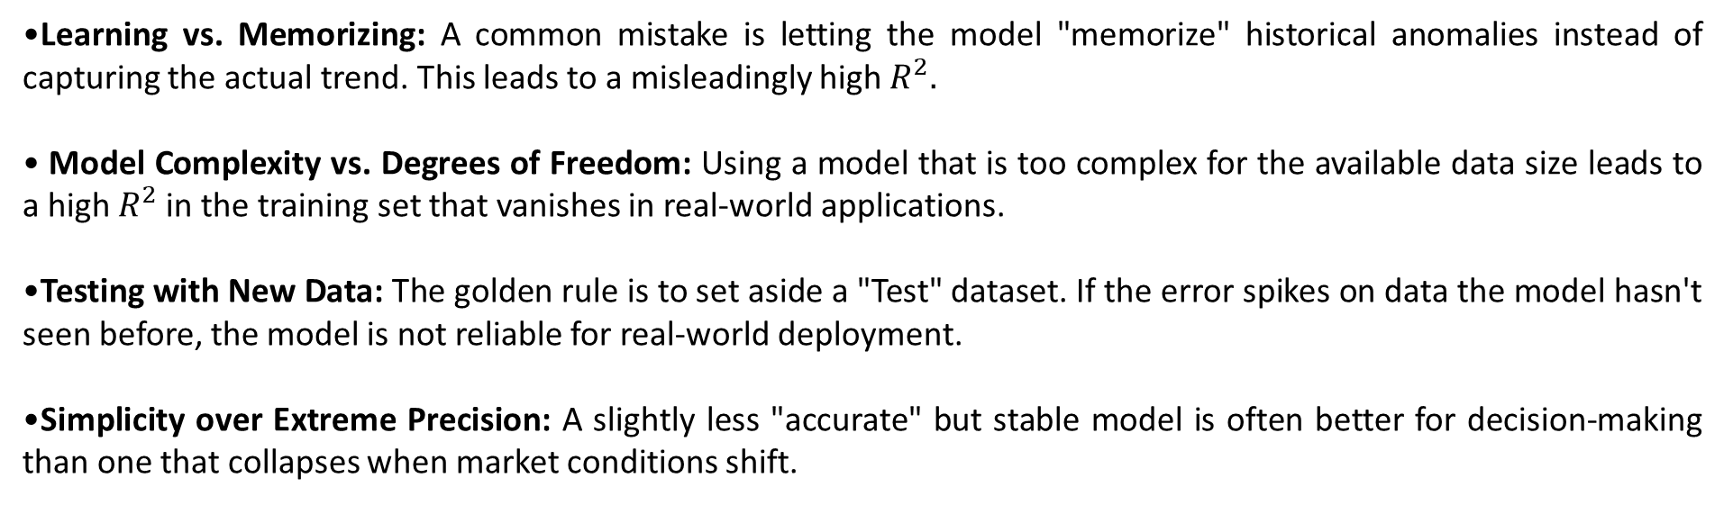
The Overfitting Trap
Why a "Perfect" Model can be a Business Risk
Learning vs. Memorizing: A common mistake is letting the model "memorize" historical anomalies instead of capturing the actual trend. This leads to a misleadingly high $R^{2}.$
Model Complexity vs. Degrees of Freedom: Using a model that is too complex for the available data size leads to a high $R^{2}$in the training set that vanishes in real-world applications.
Testing with New Data: The golden rule is to set aside a "Test" dataset. If the error spikes on data the model hasn't seen before, the model is not reliable for real-world deployment.
Simplicity over Extreme Precision: A slightly less "accurate" but stable model is often better for decision-making than one that collapses when market conditions shift.
Muñoz-Herrera and Hormazábal Class 4: Data Preparation and Predictive Models Unit II: Introduction to Machine Learning
Notes:
Let me walk you through the four units of the course so you know exactly where we're headed.
Unit I, which starts today, covers the Fundamentals of Business Intelligence — what it is, how it works, where data comes from.
Unit II moves into Data Preparation and Predictive Models — this is where you'll get your hands dirty cleaning and modeling data.
Unit III is the exciting one: Advanced Analytics and Machine Learning.
And Unit IV brings it all together with a focus on communicating insights ethically to support decision-making.
Notice how the course is structured like a pipeline: first you understand BI, then you prepare data, then you build models, and finally you communicate results. Each unit builds on the previous one — so keeping up with the pace really matters.
If at any point you feel lost, reach out early. We'd rather help you now than rescue you at the final exam.

Slide 12
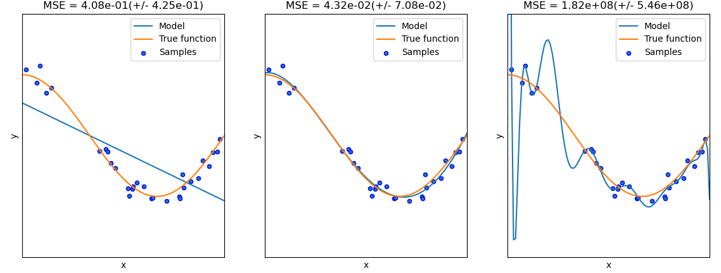
The Overfitting v/s Underfitting trade-off
Understanding your data before the modeling phase
Underfitting
Reasonable fit
Overfitting
Muñoz-Herrera and Hormazábal Class 4: Data Preparation and Predictive Models Unit II: Introduction to Machine Learning
Notes:
Let me walk you through the four units of the course so you know exactly where we're headed.
Unit I, which starts today, covers the Fundamentals of Business Intelligence — what it is, how it works, where data comes from.
Unit II moves into Data Preparation and Predictive Models — this is where you'll get your hands dirty cleaning and modeling data.
Unit III is the exciting one: Advanced Analytics and Machine Learning.
And Unit IV brings it all together with a focus on communicating insights ethically to support decision-making.
Notice how the course is structured like a pipeline: first you understand BI, then you prepare data, then you build models, and finally you communicate results. Each unit builds on the previous one — so keeping up with the pace really matters.
If at any point you feel lost, reach out early. We'd rather help you now than rescue you at the final exam.

Slide 13
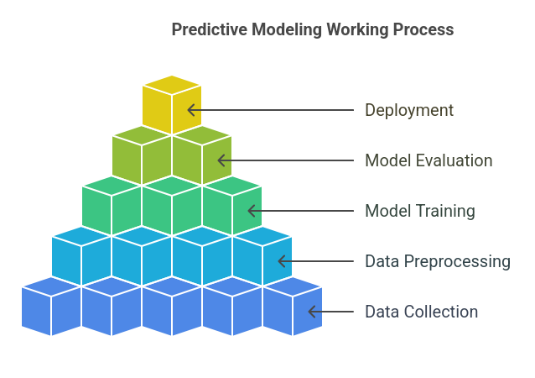
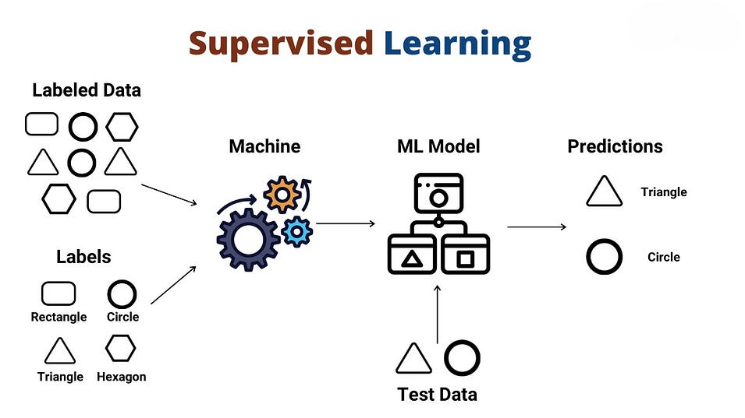
Data model decision triangle
The Strategic Framework for Predictive Business Intelligence
Muñoz-Herrera and Hormazábal Class 4: Data Preparation and Predictive Models Unit II: Introduction to Machine Learning
Notes:
Let me walk you through the four units of the course so you know exactly where we're headed.
Unit I, which starts today, covers the Fundamentals of Business Intelligence — what it is, how it works, where data comes from.
Unit II moves into Data Preparation and Predictive Models — this is where you'll get your hands dirty cleaning and modeling data.
Unit III is the exciting one: Advanced Analytics and Machine Learning.
And Unit IV brings it all together with a focus on communicating insights ethically to support decision-making.
Notice how the course is structured like a pipeline: first you understand BI, then you prepare data, then you build models, and finally you communicate results. Each unit builds on the previous one — so keeping up with the pace really matters.
If at any point you feel lost, reach out early. We'd rather help you now than rescue you at the final exam.

Slide 14

Practical Section
Google Colab — ML first project
Regression model – Simple Linear regression model
Housing dataset
Forecast
Performance metrics
Muñoz-Herrera and Hormazábal Class 1: Introduction to Business Intelligence Unit 1: Fundamentals of Business Intelligence

Slide 15
Class 4: Introduction to Machine Learning
Unit II: Data Preparation and Predictive Models
Sebastián Muñoz-Herrera, PhD.
Héctor Hormazábal

